Slide 1
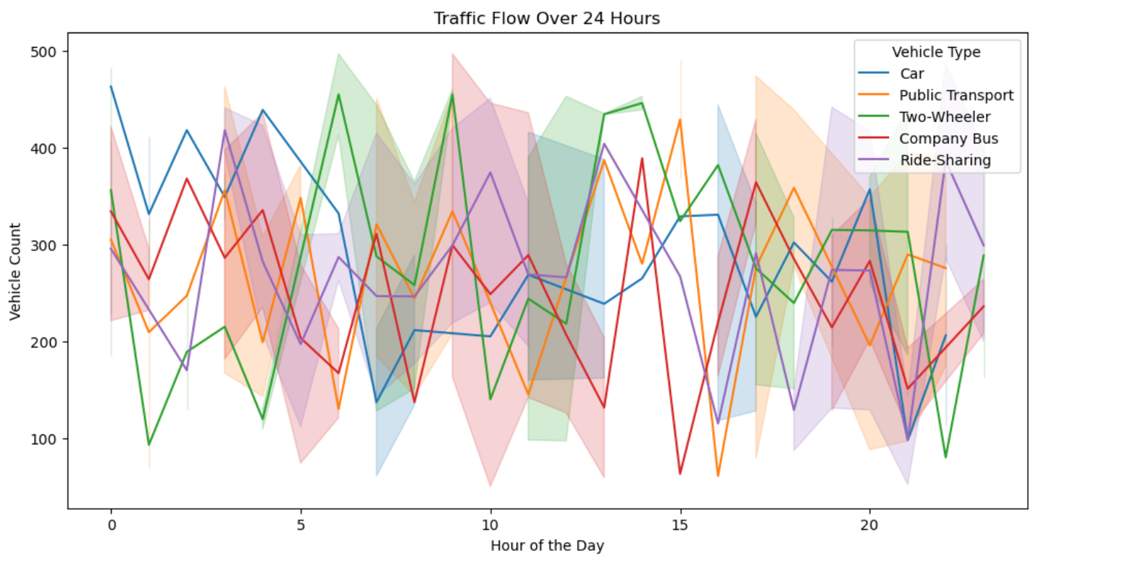
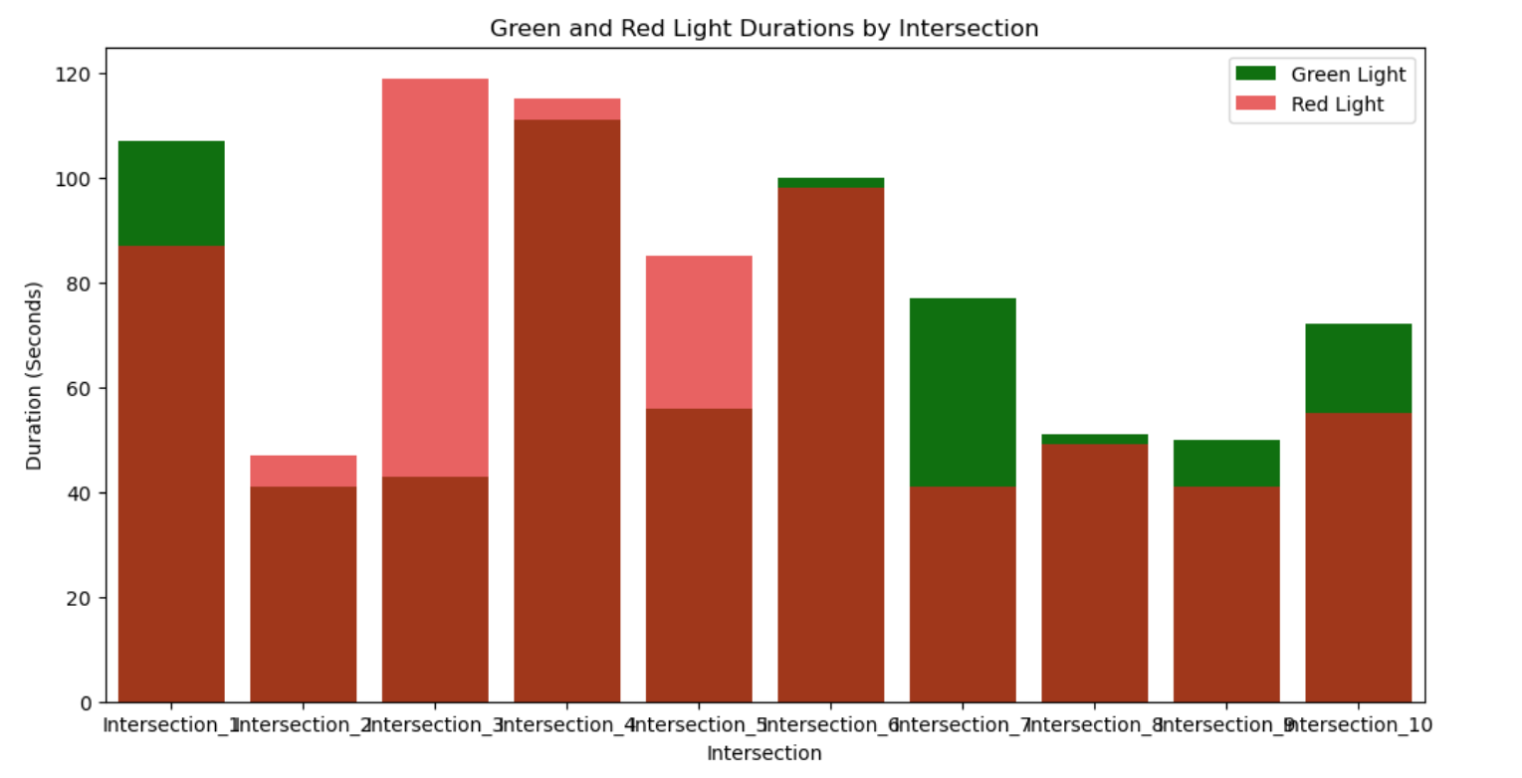
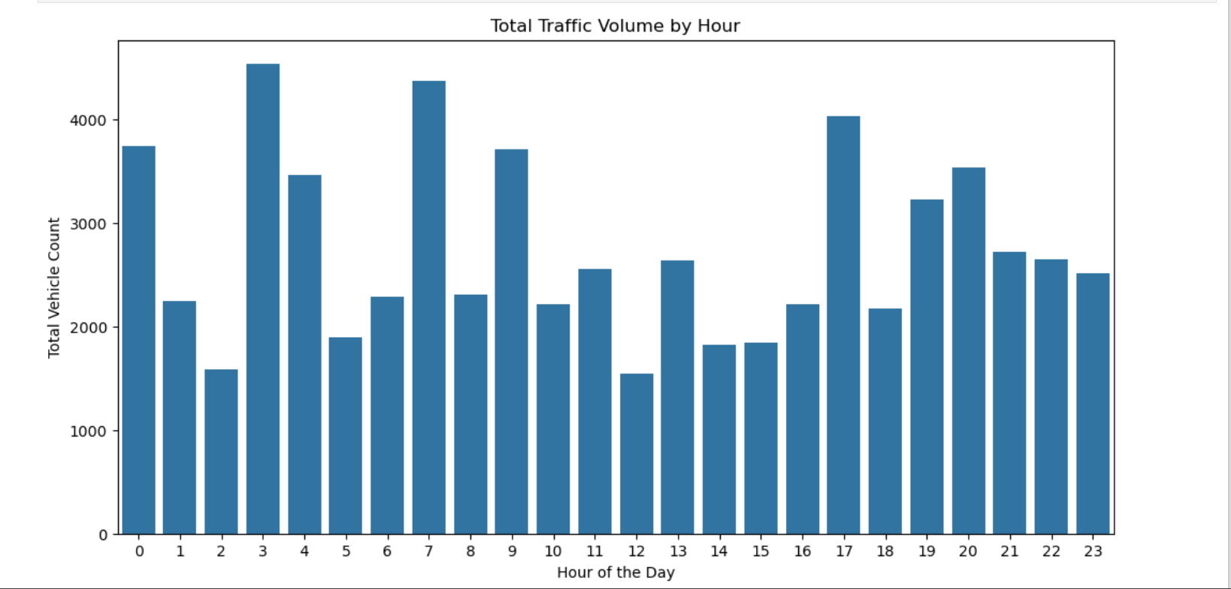
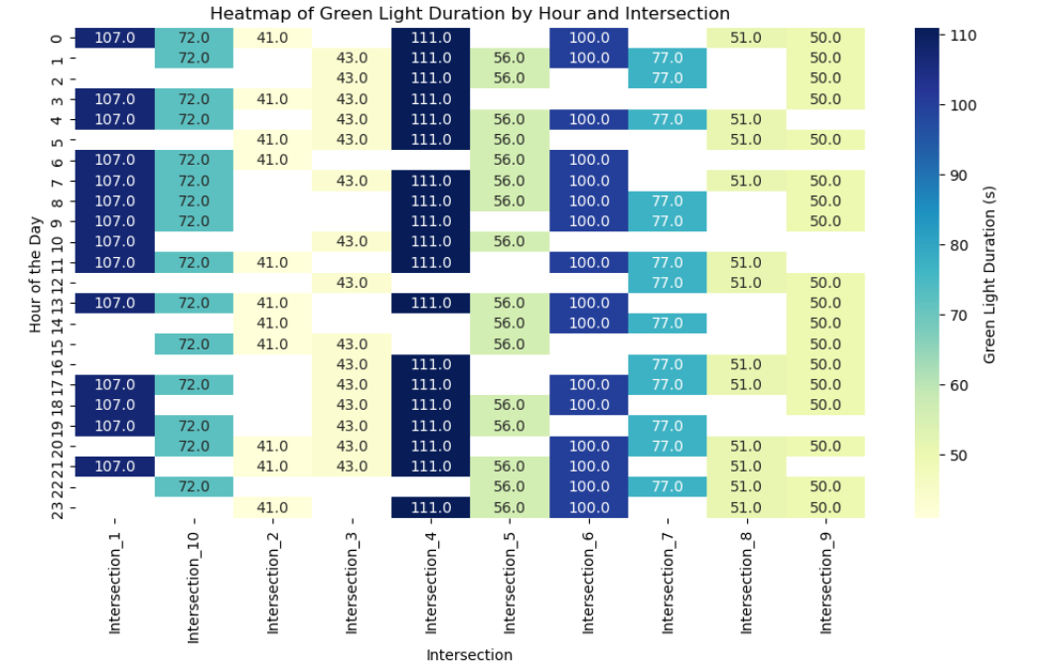
Case Study 2 - Urban Traffic Flow Optimization -- K.Ajith Varma [22BCE0720]
Insights based on Given Data
code
Graphs on Traffic Flow at each hour

Slide 2
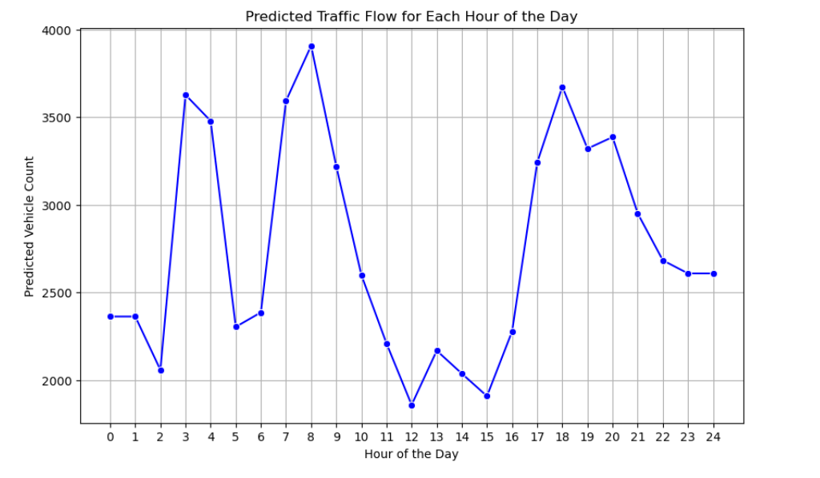
Optimization Techniques
1. Promote Public Transport and Ride-Sharing
2. Predicting Traffic Flow For Adaptive Traffic Control Systems
- Done Using RandomForest Regressor (used for approximating traffic(target function)
Max Traffic expected at 8 am followed by 6 pm
Optimizing intersection layouts also can be used to divert the traffic at certain intersection particularly during peak office hours
Also facilitating better path for public transport in Madhavaram

Slide 3
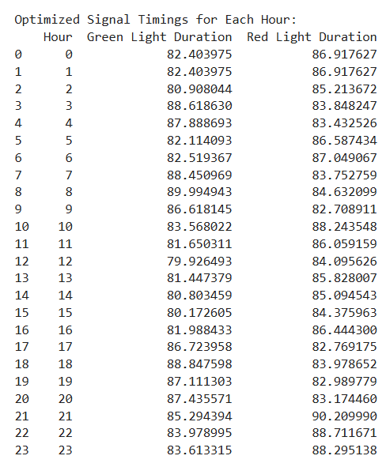
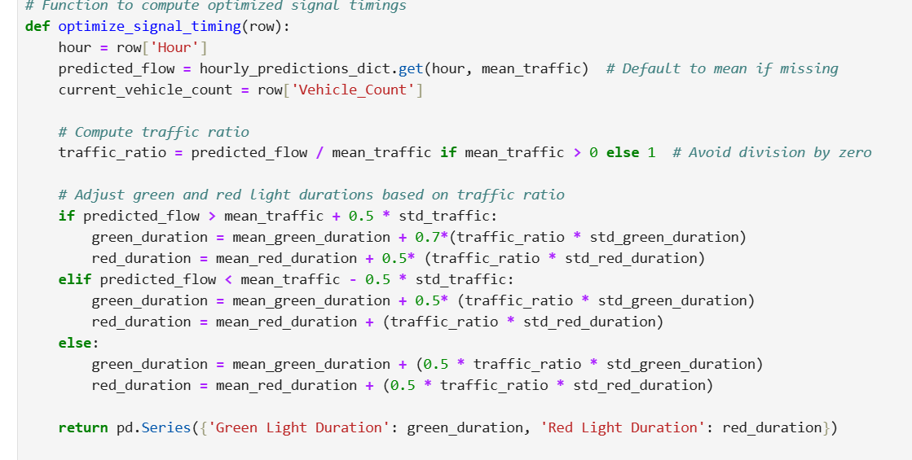
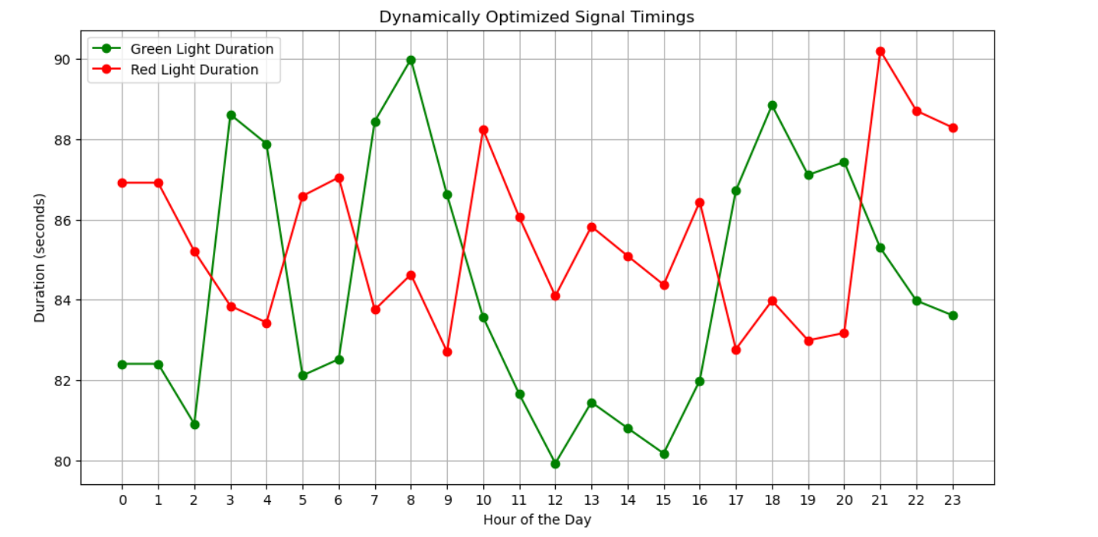
Based on the predicted traffic : 3.Optimizing Signal Timings Dynamically
Code

